Slide 1
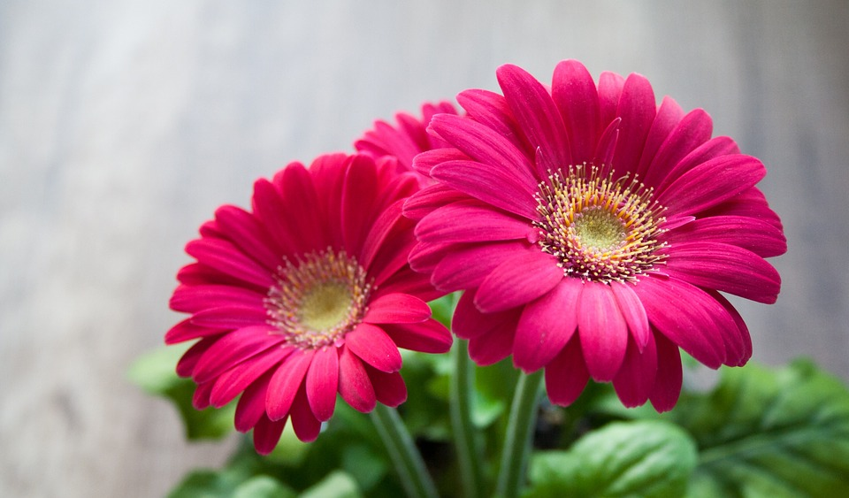
WELCOME

Slide 2
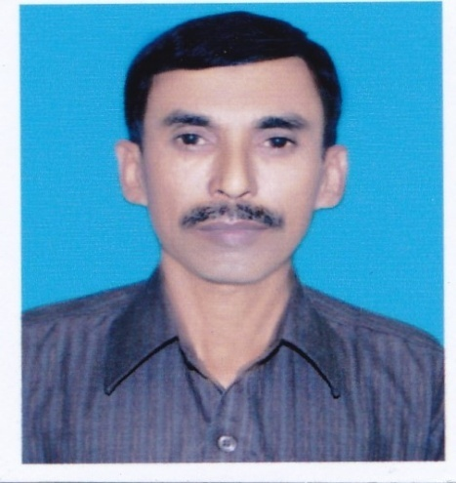
INTRODUCTION
Md. Abdul Mazed; Assistant Headteacher
Goalbathan Secondary School
P.O- Goalbathan, Magura Sadar, Magura.
Subject; English Second Papert
Class—8
Unit- Lesson-
Articles
Time—50 minutes.

Slide 3
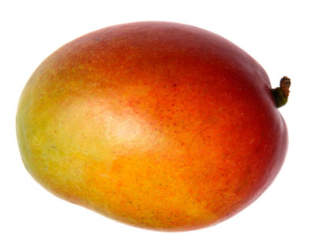
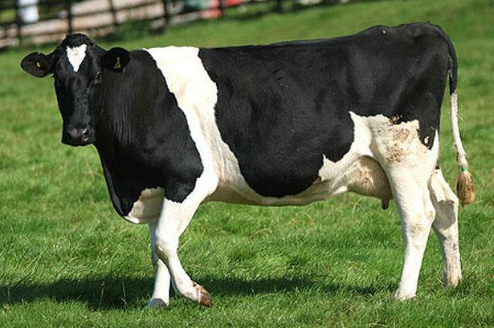
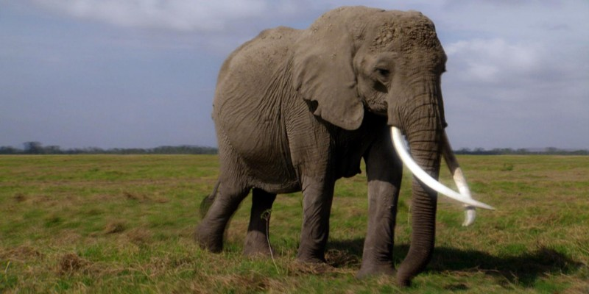
Look at the pictures and try to understand
A mango
The cow
An elephant

Slide 4
LEARNING OUTCOMES
The Students will have
*learnt what Articles are.
*learnt about the two kinds of Articles.
*learnt the uses of Articles.

Slide 5
Articles;
A, An and The are called Articles .
Articles are of two kinds; 1.Indefinite Article 2.Definite Article
Indefinite Article
Definite Article
A , A n
The

Slide 6
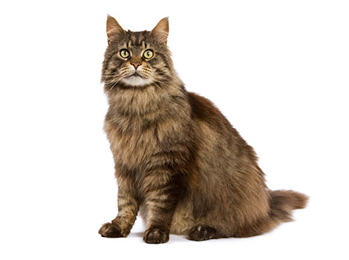
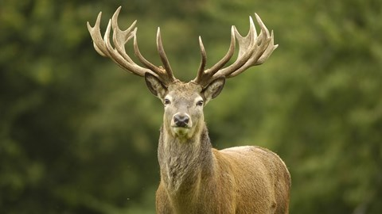
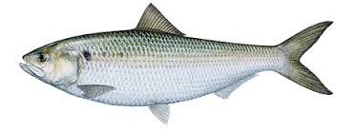

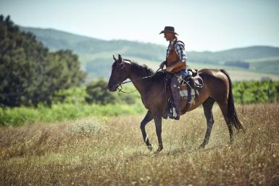
Look at the pictures and try to understand;
A cat
A mango
A deer
A fish
A flower
A horse

Slide 7
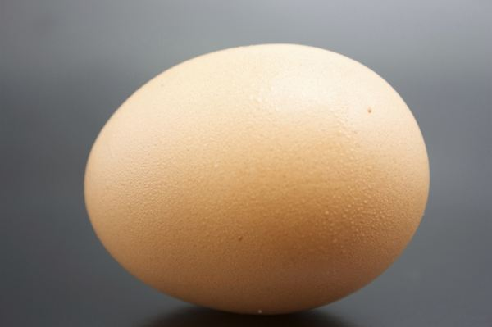
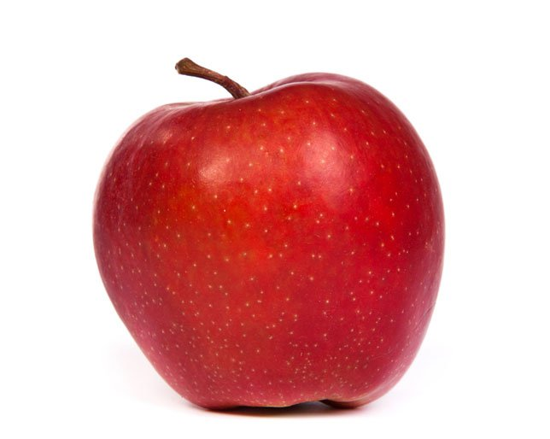
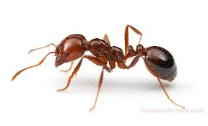

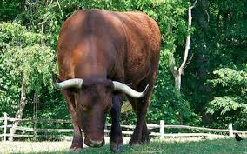
An ant
An apple
An egg
An umbrella
An ox
An elephant

Slide 8
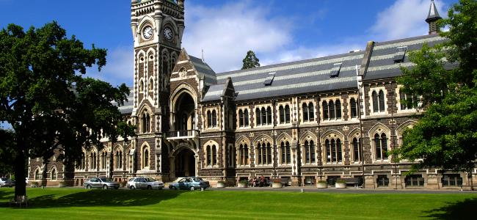
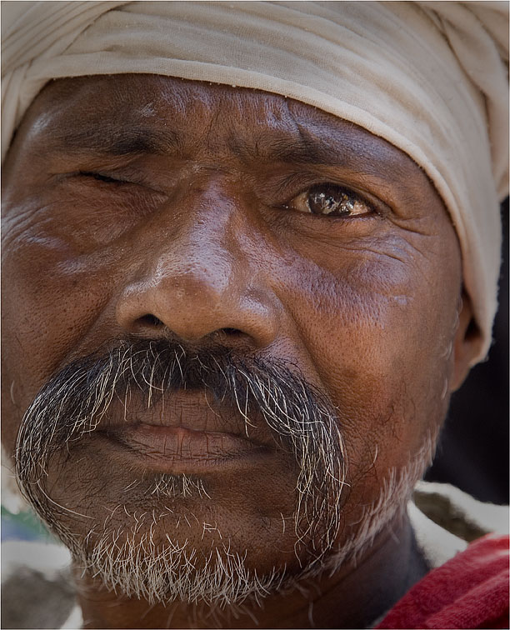
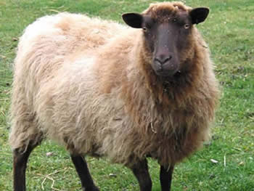
A and An are called Indefinite Articles, because they do not point out any particular person or thing. They are used only singular countable nouns.
Uses of A;
‘’A’’ is used before a consonant.
Such vowels that have the sound of ‘’you’’.
‘’o’’, when it sounds like ‘’w’’
A university
A ewe
A one eyed man

Slide 9
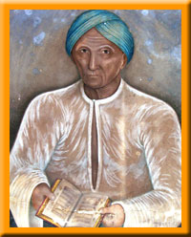
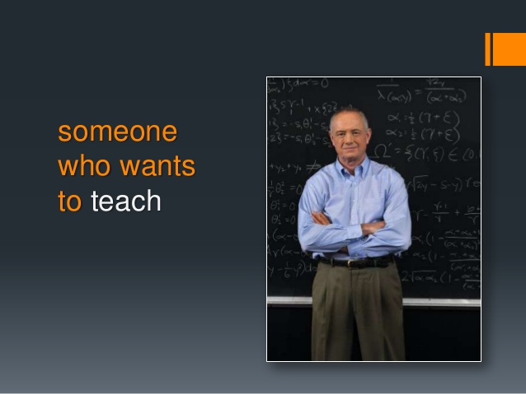
Uses of ‘’An’’
‘’An’’ is used before a vowel.
A consonant beginning with a vowel sound.
An honest man
An M.A

Slide 10
3 .’A’ and ‘An’ are sometimes used before a noun to indicate a class;
A cat is a pet animal
An ant is an industrious creature

Slide 11
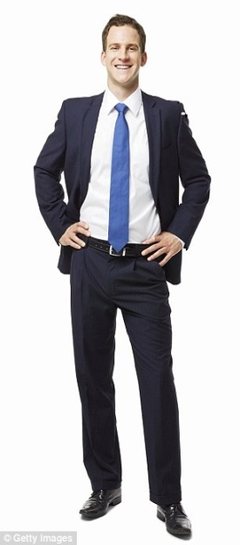
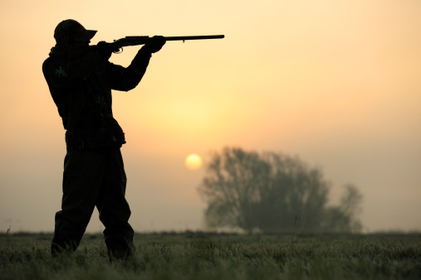
4. A is used in the sense of a certain;
A Mr. Brown came to see me
5.A is used as a preposition;
He went a hunting.(on hunting)

Slide 12
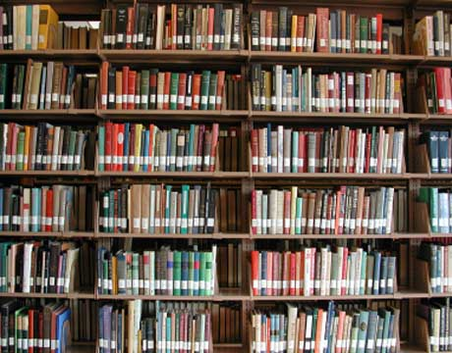
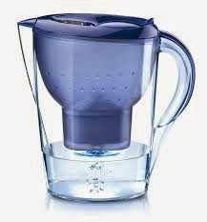
6. A is used before other determinatives;
There are a lot of books in the library
There is a little water in the jug.

Slide 13

7. ‘A’ and ‘An’ are used in a number of phrases;
The man is walking in a hurry

Slide 14
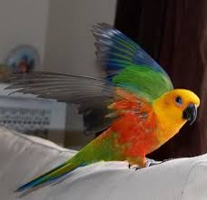

8. A or An is used in exclamatory sentences;
What a nice bird it is!
What an intelligent boy he is !

Slide 15
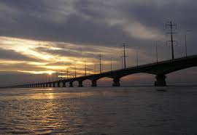
Uses of ‘The’
Look at the pictures and try to understand;
The Padma is a big river

Slide 16
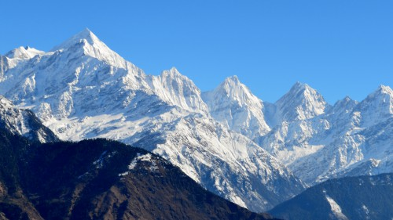
TheHimalayas are the biggest mountains in the world

Slide 17
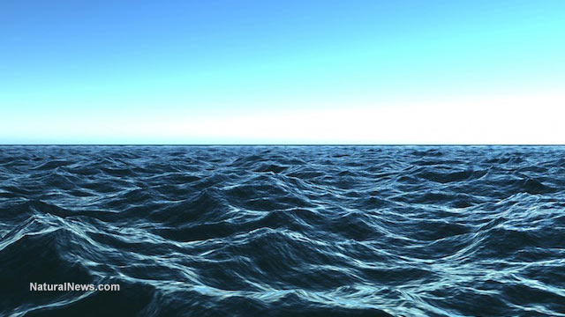
The Pacific is a big ocean

Slide 18
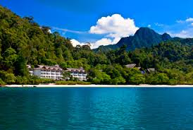
The Andamans(groups of islands)

Slide 19
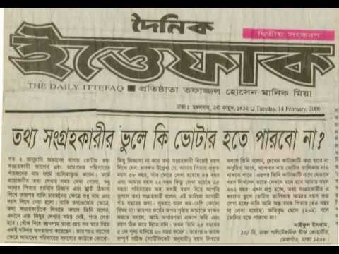
The Ittefaq is a daily newspaper

Slide 20
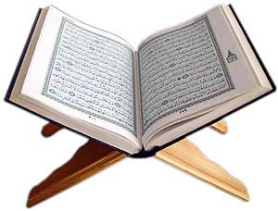
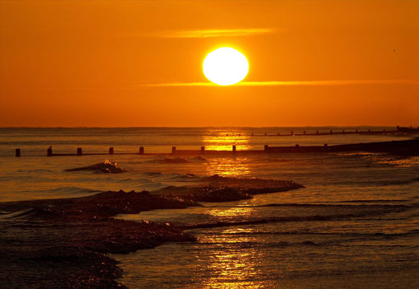
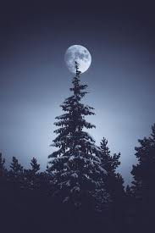
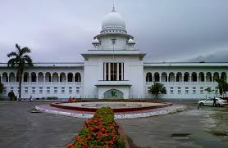
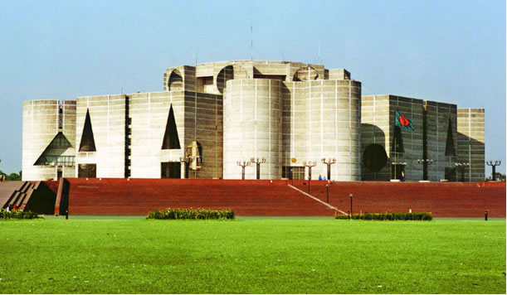
The Sun
The Moon
The Quran
The High Court
The Parliament House

Slide 21
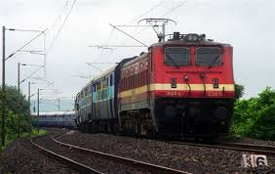
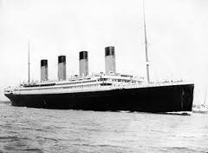
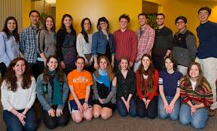

The Lalon Shah Express
The Titanic
The cow lives on grass
They went to the club

Slide 22

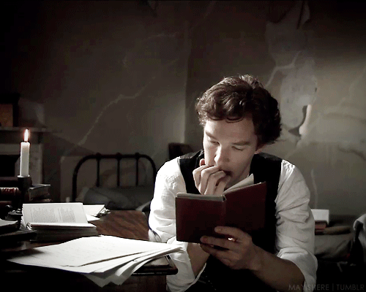
Karim is the best student in class nine.
The more you read, the more you learn.

Slide 23
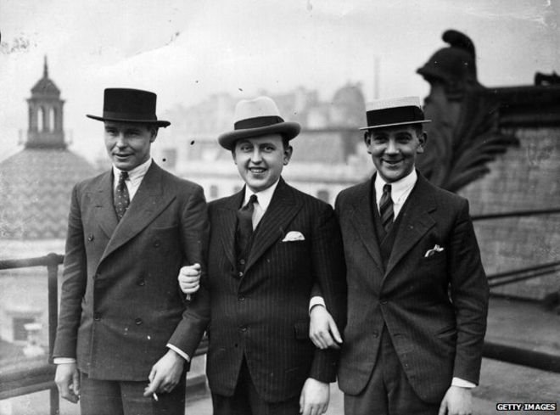
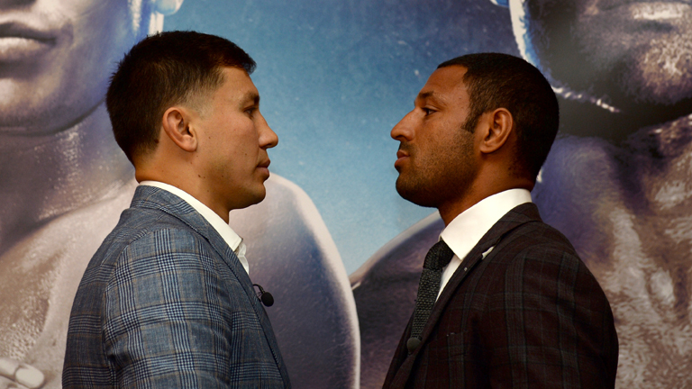
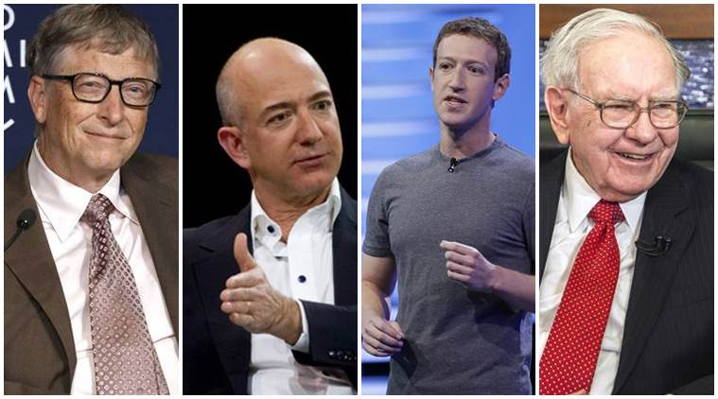
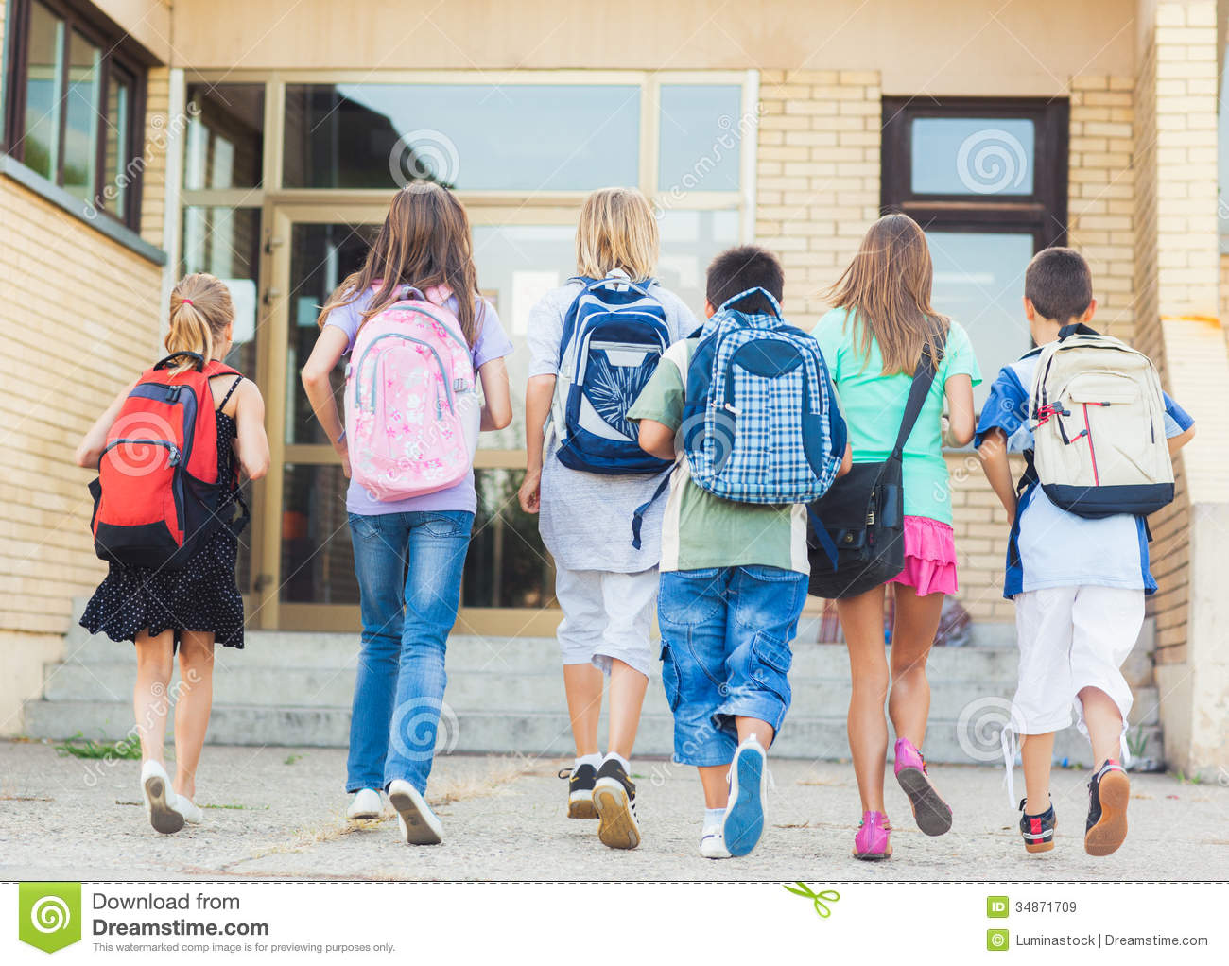
The English are industrious
He stared at him in the face
The rich are not always happy.
The students who are going to school are my friends

Slide 24
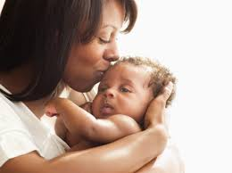
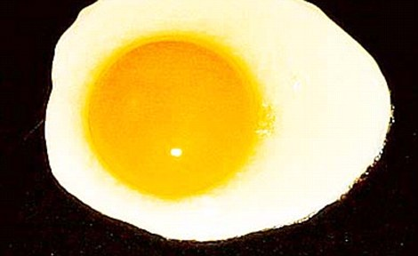
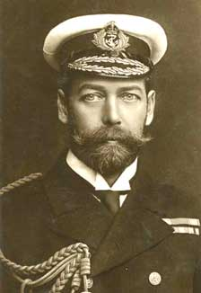
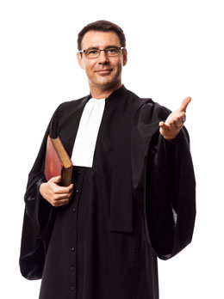
The mother in her rose at the sight of the baby
He likes the yellow of an egg
He joined the Bar
George the Fifth

Slide 25
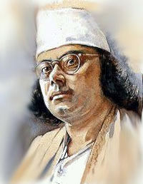
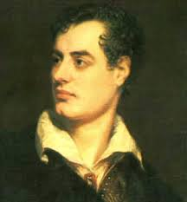
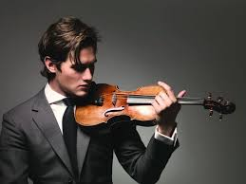
Nazrul is the Byron of Bangladesh
Nazrul
Byron
He plays the violin
The kindness of Mohin is known to all.

Slide 26
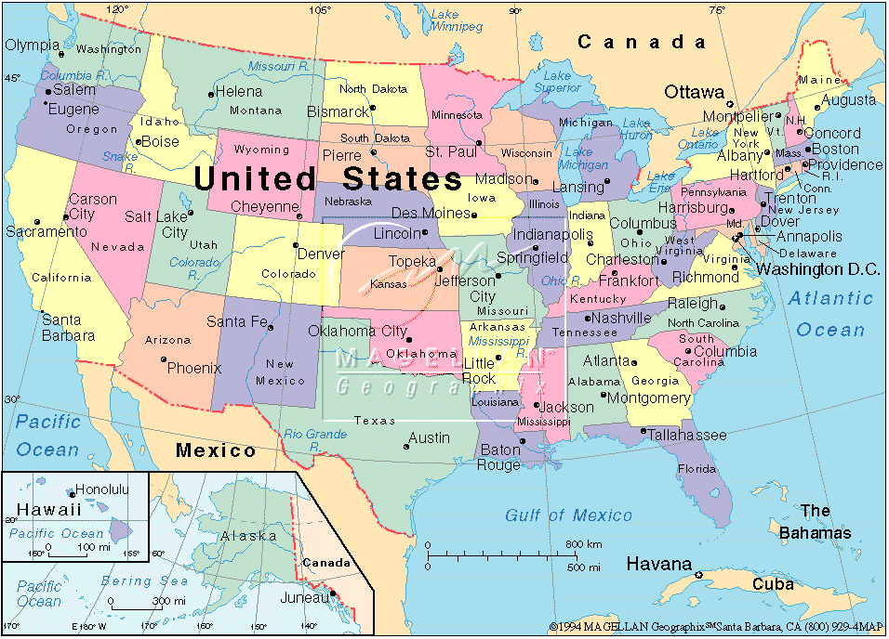
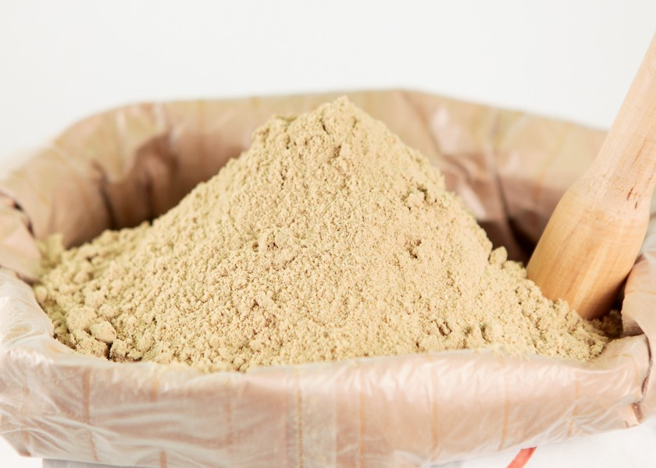
The U.S.A is a prosperous country
The rice of Barishal is very fine.

Slide 27
EVALUATION
Fill in the blanks with appropriate Articles;
He is ----university student. 2. Dhaka is----London of Bangladesh. 3.---water of this pond is not pure. 4.----honesty of the boy is praiseworthy. 5. Salam is ----better of the two boys. 6.------lion is ----beast of prey. 7.-----Bay of Bangle is to ----- south of Bangladesh. 8. His father is on
----committee. 9.----Sun rises in---east and sets in----west. 10.He reads-----Bangladesh Observer.
Use Articles where necessary;
He lives in big city in centre of Bangladesh . city is called Dhaka.He lives in old house. He is univeasity student. Name of university is Dhaka university. It is old university. Dhaka stands on Buriganga. Dhaka is capital of Bangladesh.

Slide 28

HOME WORK
Write five sentences about your pet animal and identify Articles.
THANK YOU

